Slide 1
MyCobots 320pi and Custom Ros2 Msgs.
Jacob Friedberg
1

Slide 2

Outline:
What is the MyCobot
Control Interfaces
Forward and Inverse Kinematics
Python, C++, ROS, RVIZ
PymyCobot.
How to work with the robot
Connecting.
Programming.
The project.
Project description.
Tips for the project
Custom Ros2 Messages
Interface Available
Coding example
Short Assignment
2

Slide 3
What is mycobot

Slide 4
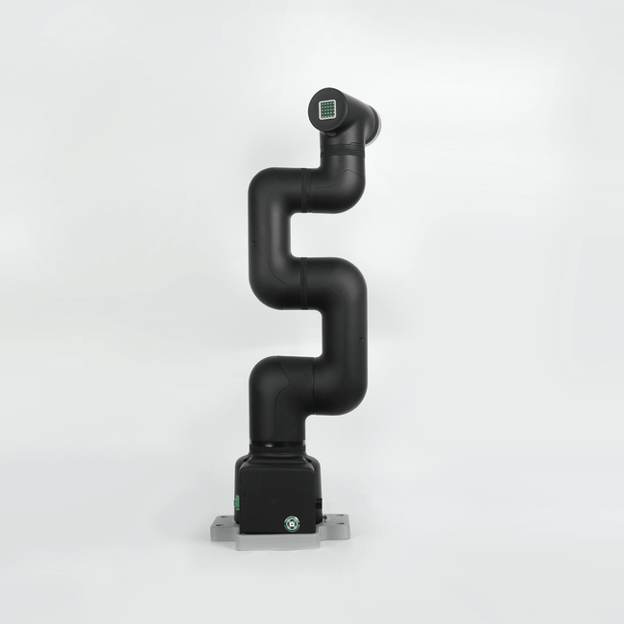
What is mycobot
6 DOF(Degrees of freedom) arm
1kg payload capacity.
350mm Working radius
24v IO
Servo motors with encoders.
E-stop capable
Raspberry pi4 B as the brain.
ESP32 to run encoders
ATOM in the EOAT
320PI2_650x.png (650×650) (shopify.com)

Slide 5
Control Interfaces

Slide 6
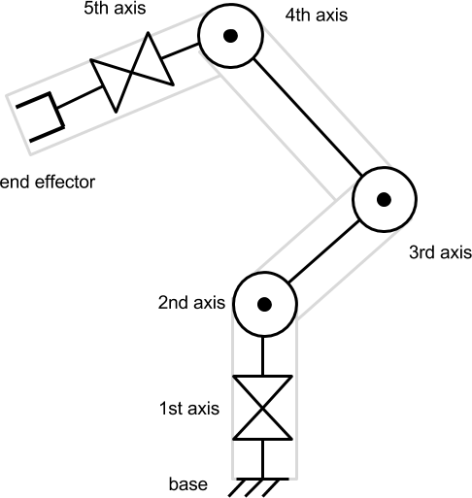
Control Interfaces
Two kinematic methods
Forward and Inverse (Mycobot can do both)
Forward kinematics
From the base of the chain forward to the end effector.
Set each joint individually by providing a list of angles
All joints forward of a change in angle are altered.
Change joint 2 and joint 3-5 move, but joint 1 does not.
IK-1.png (486×513) (alanzucconi.com)

Slide 7
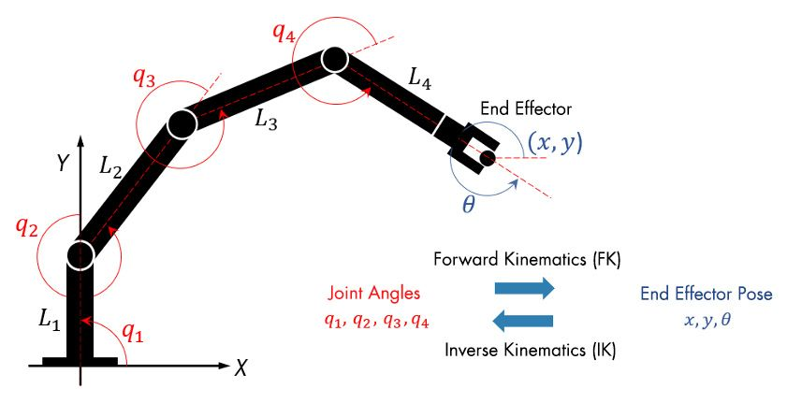
Control Interfaces
Inverse Kinematics
Reverse of forward kinematics
Choose a position in x,y,z space for the end effector, and solve for the joints to get there
Inverse kinematic solvers.
Many different types
Analytical (exact solution)
Numerical (Approximation based)
Optimization based SGD
Warning: STOCHASTIC
320PI2_650x.png (650×650) (shopify.com)

Slide 8
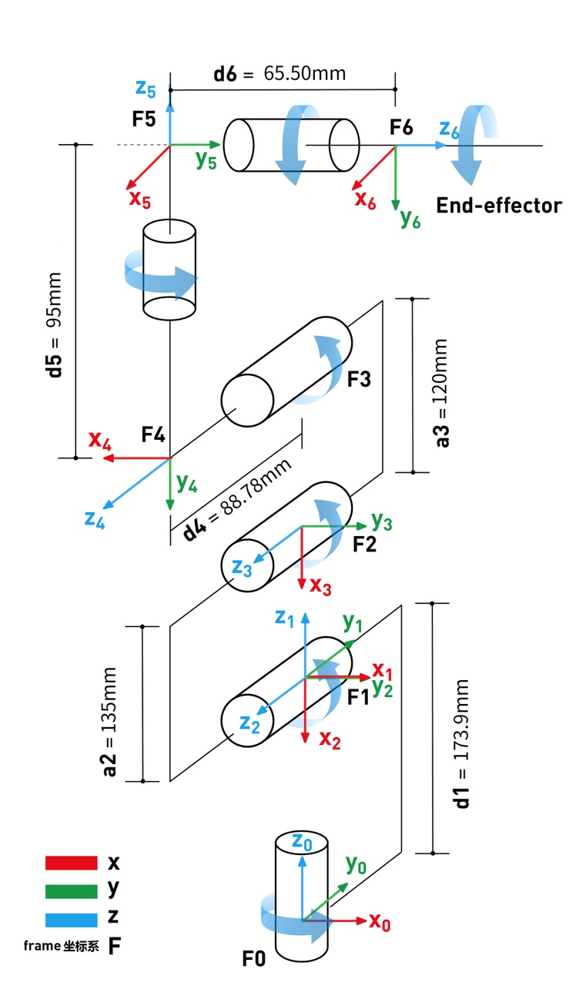
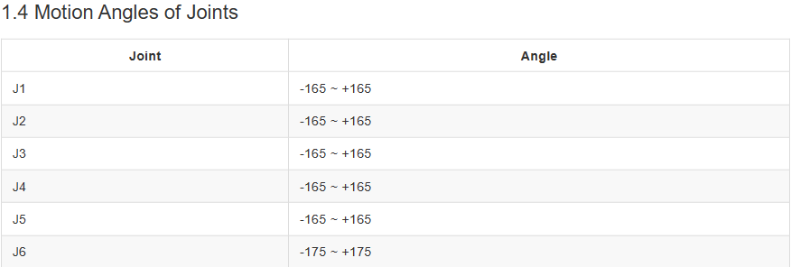
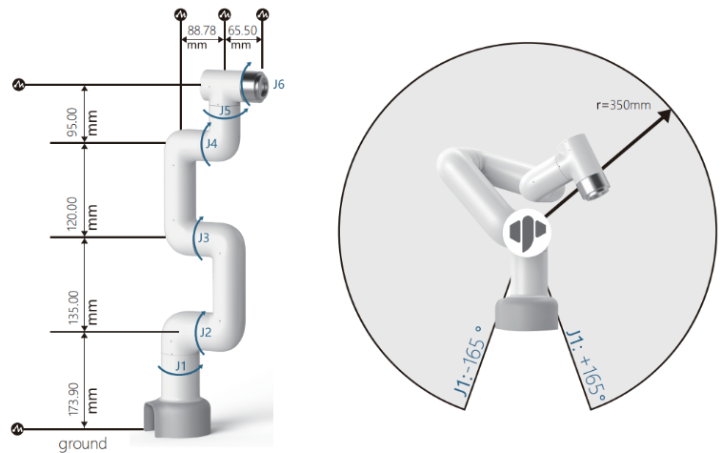
Control Interfaces

Slide 9
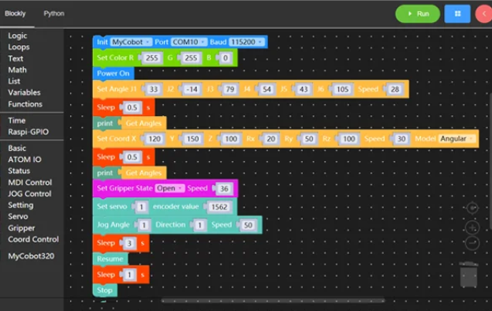
Control Interfaces
Programming interfaces
Python
PymyCobot
C++(May not be supported on our model)
C#
Java Script
Blockly(Scratch programming)
Additional programming support
ROS
ROS2
RVIZ
320PI2_650x.png (650×650) (shopify.com)

Slide 10
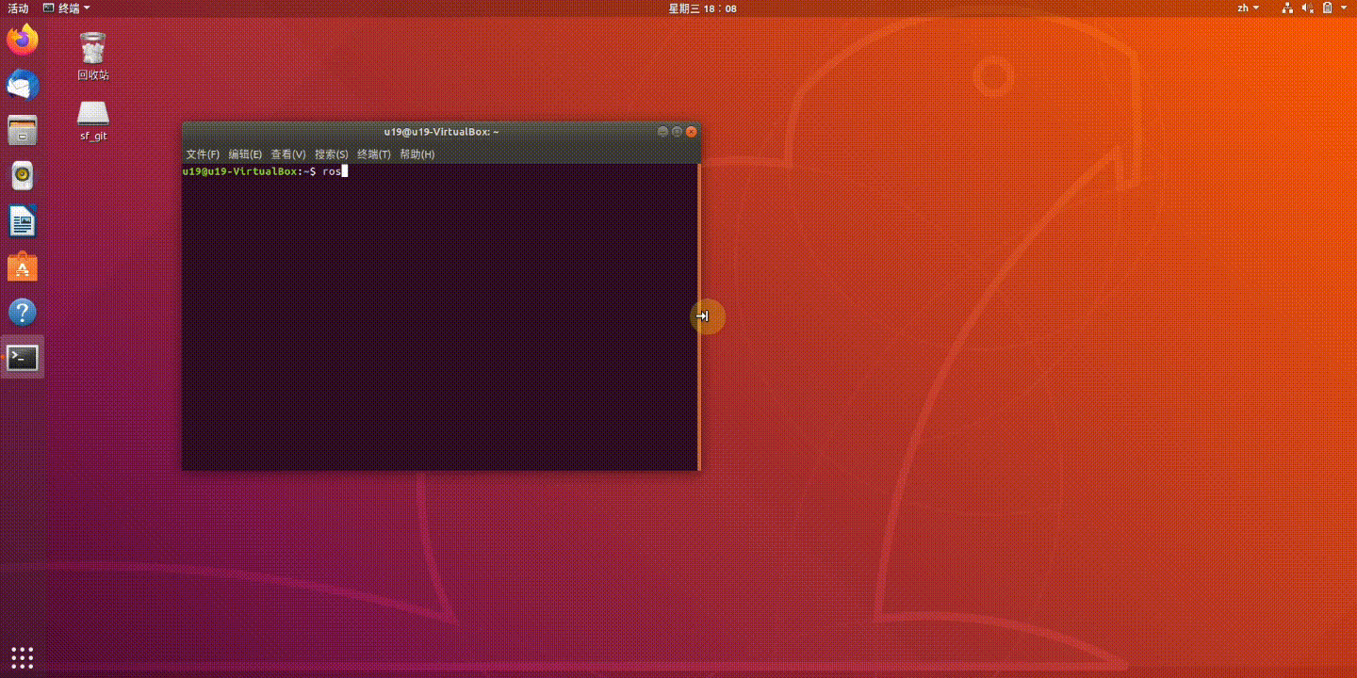
Control Interfaces

Slide 11
Control Interfaces
PymyCobot
Python Library Github
Our main tool for programming the robot.
Provides: 2 Introduction to API · GitBook (elephantrobotics.com)
Forward and Inverse kinematic control
Status functions
Gripper control
Direct Servo Control and encoder control
ROS2 Implementation on myCobot
Super minimal.
Examples, just wrap pymycobot functions in a ros2 subscriber node.

Slide 12
How to work with the robot

Slide 13
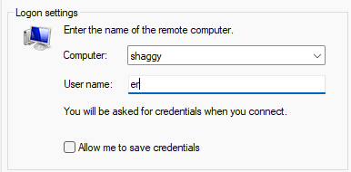
How to work with the robot
Connecting
A PDF instruction for all operating systems should have been passed around via email(Thanks Kristie)
Short version
The Scooby class robots have been named based on the sticker on them. We have Velma and Shaggy.
Connect to the AirVandalRobotMoscow network
Using a remote desktop connection program(Microsoft or equivalent) provide the host name(Name of robot, shaggy or velma) and provide “er” as the username.
Use the password REDACTED to login

Slide 14
How to work with the robot
Programming the Robot.
The process for programming the Robot with ROS2 is straightforward but crude.
Since there are no action clients/servers we have to make our own.
You could implement your own action servers(ROS2 Action Server) or make a very basic version using publishers and subscribers.
You will create some nodes(likely subscribers) on the MyCobot to receive a message/goal(start some action perhaps?) and perform an action using the pymycobot API.
Publish a message to indicate you are done.
Connect everything up on your laptop using RCLPY similar to the create3 projects. Sequence everything in one place.

Slide 15
The Project

Slide 16
The Project
The Goal
You will have 3 robots in total. 1 create3 and 2 elephant robot arms
Start with the create3 near one of the arms. You will need to have one of the arms pick up an object and place it on top of the create 3.
Have the create 3 drive to the other arm across the room. This can be a straight line if you so choose.
You are allowed to use multiple docking stations to give you points of reference in the path.
Stop the create3 Infront of the other arm.
Have the arm unload the create 3.

Slide 17
The Project
Tips
First thing to do: Define how you are going to synchronize actions between the robots.
In my mind this can be done by sending custom messages to the robot on a specific topic to indicate state.
Smart sequencer that orchestrates all movement.
You can work on each part individually and integrate at the end but don’t wait too long. Unexpected issues happen.
You need to build the supporting RCLPY functions on the MyCobots to use in your Project program.

Slide 18
Custom Ros2 Messages

Slide 19
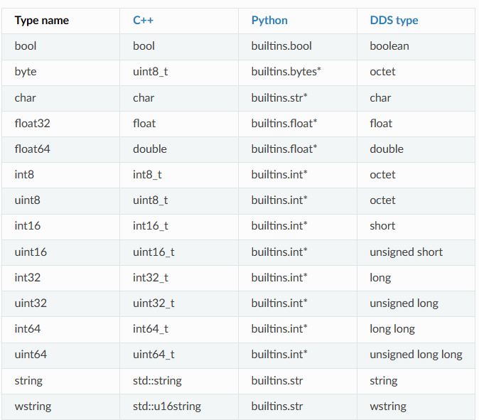
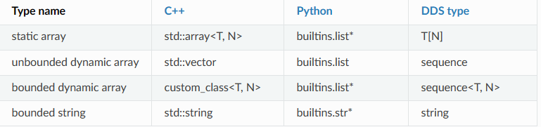
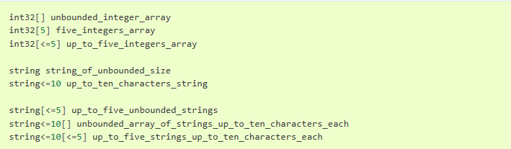
Custom Ros2 Messages
ROS2 Messages
A way to send data between Robots and ROS2 Nodes. We used the hazard vector which is a message for the Create 3.
Subset of types available.

Slide 20
Custom Ros2 Messages
CODING EXAMPLE
Creating custom msg and srv files — ROS 2 Documentation: Humble documentation

Slide 21
Short Assignment

Slide 22
Short Assignment
Connect to the robot and make it move in any way.
Show me you are ready to program the project.
Turn in a video or show me in person.
Submit 1 per group(3 total submissions)

